Slide 1
Chapter Fourteen
Consumer’s Surplus

Slide 2
Questions
How can we…
Find a monetary measure of a consumer’s happiness?
Evaluate the willingness to pay for a unit?
Quantify the effect of economic policy on consumers?

Slide 3
Examples
Suppose you had to pay to download iTunes but once you did, you could buy songs for $1
Or you have to pay a cover to get into a bar and then beers are $3 a pint.
What is the most you would pay to enter these markets?

Slide 4
Monetary Measures of Gains-to-Trade
Three such measures are:
  Consumer’s Surplus
  Equivalent Variation, and
  Compensating Variation.
Only in one special circumstance do these three measures coincide.

Slide 5
$ Equivalent Utility Gains
Suppose gasoline can be bought only in lumps of one gallon.
Use r₁ to denote the most a single consumer would pay for a 1st gallon (called reservation price for the 1st gallon).
r₁ is the dollar equivalent of the marginal utility of the 1st gallon.

Slide 6
$ Equivalent Utility Gains
Use r₂ to denote the most she would pay for a 2nd gallon -- this is her reservation price for the 2nd gallon.
r₂ is the dollar equivalent of the marginal utility of the 2nd gallon.

Slide 7
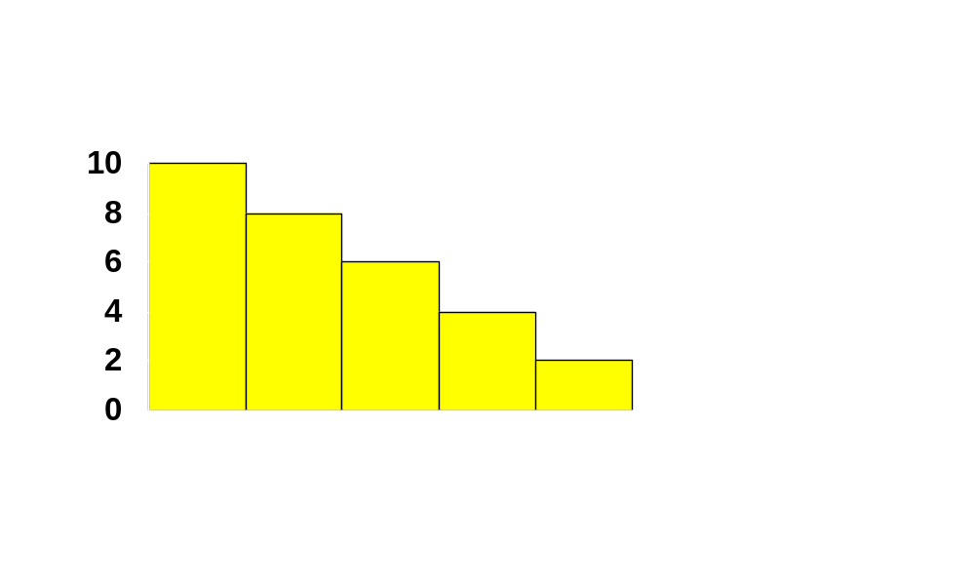
$ Equivalent Utility Gains
r₁
r₂
r₃
r₄
r₅
r₆
1
2
3
4
5
6

Slide 8
$ Equivalent Utility Gains
Why does this picture make sense only for QSL preferences?
What is the monetary value of our consumer’s gain-to-trading in the gasoline market at a price of $p_{G}?

Slide 9
$ Equivalent Utility Gains
r₁
r₂
r₃
r₄
p_{G}
r₅
r₆
1
2
3
4
5
6

Slide 10
$ Equivalent Utility Gains
r₁
r₂
r₃
r₄
p_{G}
r₅
r₆
1
2
3
4
5
6

Slide 11
$ Equivalent Utility Gains
$ value of net utility gains-to-trade
r₁
r₂
r₃
r₄
p_{G}
r₅
r₆
1
2
3
4
5
6

Slide 12
$ Equivalent Utility Gains
Now suppose that gasoline is sold in half-gallon units.

Slide 13
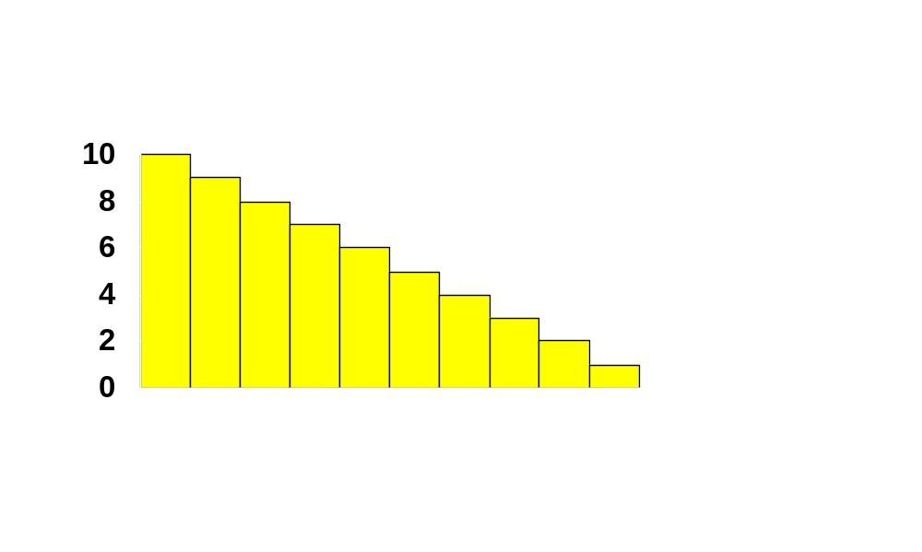
$ Equivalent Utility Gains
r₁
r₃
r₅
r₇
r₉
r₁₁
1
2
3
4
5
6
7
8
9
10
11

Slide 14
$ Equivalent Utility Gains
r₁
r₃
r₅
r₇
p_{G}
r₉
r₁₁
1
2
3
4
5
6
7
8
9
10
11

Slide 15
$ Equivalent Utility Gains
$ value of net utility gains-to-trade
r₁
r₃
r₅
r₇
p_{G}
r₉
r₁₁
1
2
3
4
5
6
7
8
9
10
11

Slide 16
$ Equivalent Utility Gains
And if gasoline is available in one-quarter gallon units ...

Slide 17

$ Equivalent Utility Gains
1
2
3
4
5
6
7
8
9
10
11

Slide 18
$ Equivalent Utility Gains
p_{G}
1
2
3
4
5
6
7
8
9
10
11

Slide 19
$ Equivalent Utility Gains
$ value of net utility gains-to-trade
p_{G}

Slide 20
$ Equivalent Utility Gains
Consumer (net) surplus:
CS= r₁ + r₂ +…+ r_{n} – pn
Where v(n) = r₁ + r₂ +…+ r_{n}

Slide 21
$ Equivalent Utility Gains
Finally, if gasoline can be purchased in any quantity then ...

Slide 22
$ Equivalent Utility Gains
($) Res.
Prices
Reservation Price Curve for Gasoline
Gasoline

Slide 23
$ Equivalent Utility Gains
($) Res.
Prices
Reservation Price Curve for Gasoline
p_{G}
Gasoline

Slide 24
$ Equivalent Utility Gains
($) Res.
Prices
Reservation Price Curve for Gasoline
$ value of net utility gains-to-trade
p_{G}
Gasoline

Slide 25
$ Equivalent Utility Gains
Estimating a consumer’s reservation price curve is difficult,
Approximation: the reservation-price curve is replaced with the consumer’s ordinary demand curve.

Slide 26
Consumer’s Surplus
A consumer’s reservation-price curve is not quite the same as her ordinary demand curve. Why not?
A reservation-price curve describes sequentially the values of successive single units of a commodity (remaining income decreases as you buy).
An ordinary demand curve describes the most that would be paid for q units of a commodity purchased simultaneously.

Slide 27
Consumer’s Surplus
($)
Reservation price curve for gasoline
Ordinary demand curve for gasoline
Gasoline

Slide 28
Consumer’s Surplus
The difference between the consumer’s reservation-price and ordinary demand curves is due to income effects.

Slide 29
Consumer’s Surplus
Ordinary demand for good 1.
Fix p₂ and m.
Inverse demand p₁(x₁).
If consumer consumes x’₁ then
CS=

Slide 30
Consumer’s Surplus
Consumer’s Surplus is an exact dollar measure of utility gained when utility function is quasilinear.
Otherwise Consumer’s Surplus is an approximation.

Slide 31
Compensating Variation and Equivalent Variation
Two additional dollar measures of the total utility change caused by a price change are Compensating Variation and Equivalent Variation.

Slide 32
Compensating Variation
p₁ rises.
Q: What is the least extra income that, at the new prices, just restores the consumer’s original utility level?

Slide 33
Compensating Variation
p₁ rises.
Q: What is the least extra income that, at the new prices, just restores the consumer’s original utility level?
A: The Compensating Variation.

Slide 34
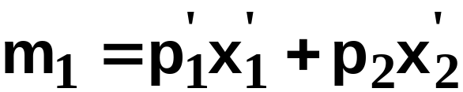


Compensating Variation
p₁=p₁’
p₂ is fixed.
x₂
u₁
x₁

Slide 35
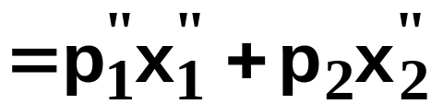


Compensating Variation
p₁=p₁’
p₁=p₁”
p₂ is fixed.
x₂
u₁
u₂
x₁

Slide 36
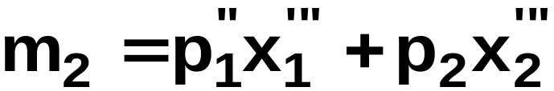

Compensating Variation
p₁=p₁’
p₁=p₁”
p₂ is fixed.
x₂
u₁
u₂
x₁

Slide 37
Compensating Variation
p₁=p₁’
p₁=p₁”
p₂ is fixed.
x₂
u₁
u₂
CV = m₂ - m₁.
x₁

Slide 38
Equivalent Variation
p₁ rises.
Q: How much money would have to be taken away from the consumer before the price change to leave him as well off as after the change?
A: The Equivalent Variation.

Slide 39
Equivalent Variation
p₁=p₁’
p₂ is fixed.
x₂
u₁
x₁

Slide 40
Equivalent Variation
p₁=p₁’
p₁=p₁”
p₂ is fixed.
x₂
u₁
u₂
x₁

Slide 41
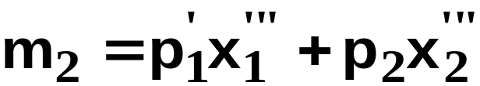
Equivalent Variation
p₁=p₁’
p₁=p₁”
p₂ is fixed.
x₂
u₁
u₂
x₁

Slide 42
Equivalent Variation
p₁=p₁’
p₁=p₁”
p₂ is fixed.
x₂
u₁
u₂
EV = m₁ - m₂.
x₁

Slide 43
Consumer’s Surplus, Compensating Variation and Equivalent Variation
Relationship 1: When the consumer’s preferences are quasilinear, all three measures are the same.

Slide 44
Consumer’s Surplus, Compensating Variation and Equivalent Variation
Consider first the change in Consumer’s Surplus when p₁ rises from p₁’ to p₁” (which leads the demand to change from x₁’ to x₁”)

Slide 45


Consumer’s Surplus, Compensating Variation and Equivalent Variation
If
then

Slide 46
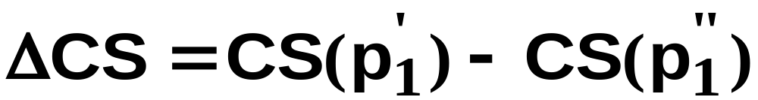
Consumer’s Surplus, Compensating Variation and Equivalent Variation
If
then
and so the change in CS when p₁ rises
from p₁’ to p₁” is

Slide 47
Consumer’s Surplus, Compensating Variation and Equivalent Variation
If
then
and so the change in CS when p₁ rises
from p₁’ to p₁” is

Slide 48
Consumer’s Surplus, Compensating Variation and Equivalent Variation
If
then
and so the change in CS when p₁ rises
from p₁’ to p₁” is

Slide 49
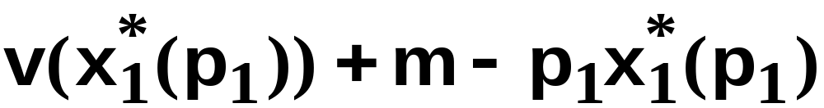
Consumer’s Surplus, Compensating Variation and Equivalent Variation
Now consider the change in CV when p₁ rises from p₁’ to p₁”.
The consumer’s utility for given p₁ is
and CV is the extra income which, at the new prices, makes the consumer’s utility the same as at the old prices. That is, ...

Slide 50
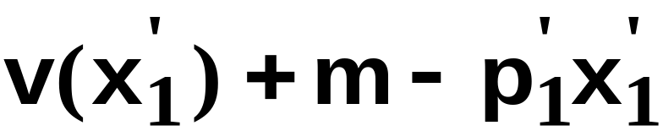
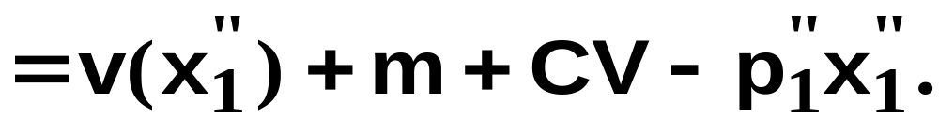
Consumer’s Surplus, Compensating Variation and Equivalent Variation

Slide 51

Consumer’s Surplus, Compensating Variation and Equivalent Variation
So

Slide 52
Consumer’s Surplus, Compensating Variation and Equivalent Variation
Now consider the change in EV when p₁ rises from p₁’ to p₁”.
The consumer’s utility for given p₁ is
and EV is the extra income which, at the old prices, makes the consumer’s utility the same as at the new prices. That is, ...

Slide 53

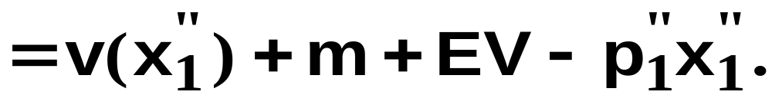
Consumer’s Surplus, Compensating Variation and Equivalent Variation

Slide 54
Consumer’s Surplus, Compensating Variation and Equivalent Variation
That is,

Slide 55
Consumer’s Surplus, Compensating Variation and Equivalent Variation
So when the consumer has quasilinear
utility,
CV = EV = ΔCS.
But, otherwise, we have:
Relationship 2: In size, EV < ΔCS < CV.

